Slide 1
Ford Ka Data Analysis
Project 1 | Jiayuan Xu

Slide 2
Ford (and Car Manufacturers) Car Market Segmentation
Ford and other car manufacture generally segmented the car market by income and age since the size of a car was strongly correlated with production cost and thus with price.
The typical small car marketing strategy in the past were targeting to younger, lower income buyers via direct mailing.
The existing segmentation approach for Ford was not applicable due to environmental and demographic changes significantly during the 1980s and the early 1990s. There was significant demographic that the increasing number of working women in France led to a rise in the number of women buyers.

Slide 3
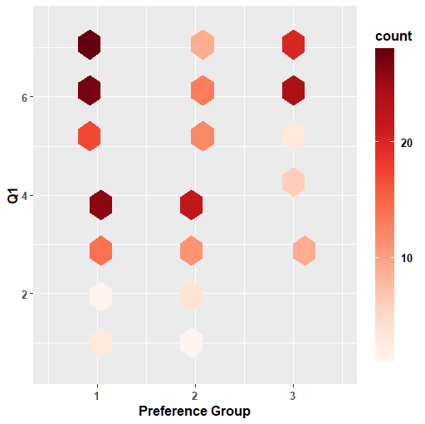
Data Analysis For Relationship between Q1 and Preference Group
Hexagonal Binning plot
Most of Ka chooser and the middle agree with that “I want a car that is trendy.” And Most Ka Non-chooser neither agree nor disagree with that.
We can conclude that consumers choose to buy a trendy car, and Ford Ka is a trendy car for majority of consumers in the car market generally.
Strongly Agree
Strongly Disagree
1 | Ka Chooser (top 3)
2 | Ka Non-Chooser (bottom 3)
3 | Middle (middle 4)

Slide 4
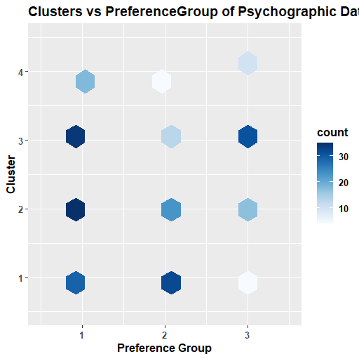
K-Means Clustering Psychographic Data Analysis
It is obvious to see that cluster 2 and 3 has more responses which chose preference group 1 than cluster 1 and 4.
Therefore, we would target in cluster 2 and 3 to analyze which questions in those clusters got high points or low points in order to find out our potential customers’ thoughts.

Slide 5
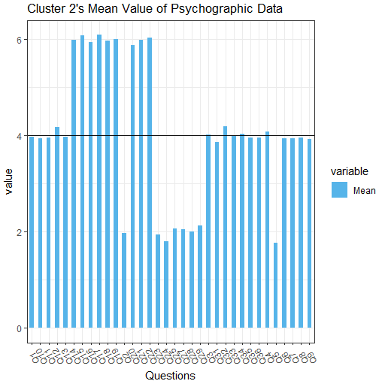
K-Means Clustering Psychographic Data Analysis
Based on the high mean of Q22 (Small cars are much safer nowadays),
Q14 (The car I buy must be able to handle long motorway journeys),
Q17 (I want a car that is nippy and zippy),
Q19 (I wish there were stricter exhaust regulations),
it is important for potential customers to own fashion small cars with high quality and safety.
Strongly Agree
Neutral
Strongly Disagree

Slide 6
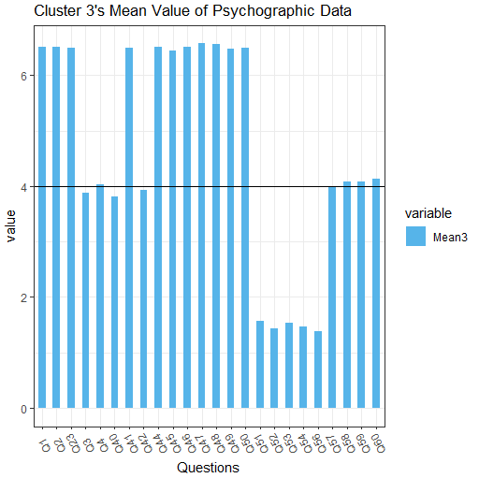
K-Means Clustering Psychographic Data Analysis
Based on the high mean of Q1(I want a car that is trendy),
Q2(I am fashion conscious),
Q41 (In today's world it is anti-social to drive big cars),
Q46 (I always want the latest style and design in a vehicle),
In conclusion, potential customers would like to own fashion small car.
Strongly Agree
Neutral
Strongly Disagree

Slide 7
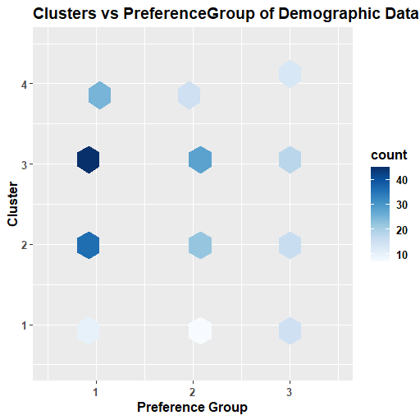
K-Means Clustering Demographic Data Analysis
According to the graph, cluster 2 and 3 has more responses which chose preference group 1 than cluster 1 and 4.
Therefore, we would target in cluster 2 and 3 to analyze which types of customers are our main target customers. In addition, we also can find out in cluster 1 and 4 to see which types of customers we are not interesting in.

Slide 8
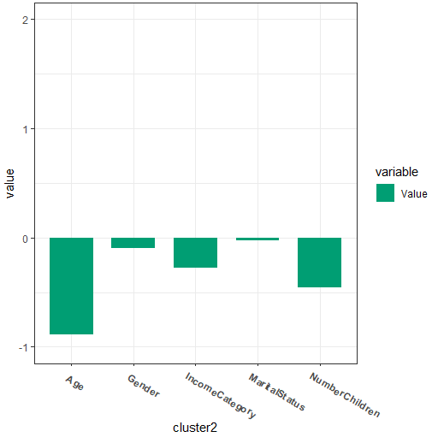
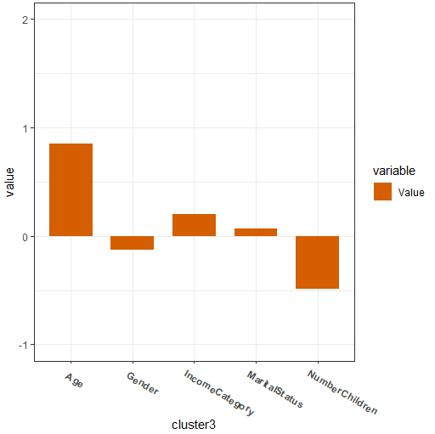
K-Means Clustering Demographic Data Analysis
Cluster 2 represents younger male customers with less number of children.
Cluster 3 represents older single male customers with less number of children.
Therefore, we can conclude with combining “cluster vs preference group” graph that younger and older male customers with less number of children could be our target costumers.

Slide 9
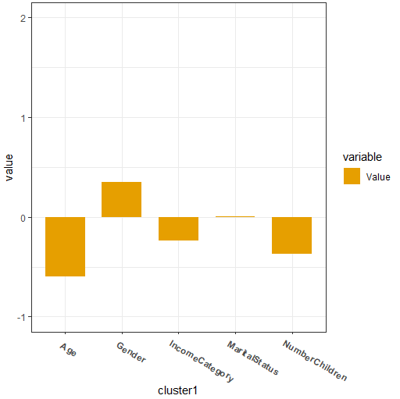
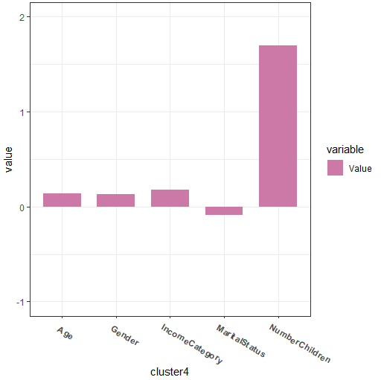
K-Means Clustering Demographic Data Analysis
Cluster 1 represents young female customers with less number of children.
Cluster 4 represents 30’s female married customers with more number of children.
Therefore, we can conclude with combining “cluster vs preference group” graph that young and 30’s female customers with more number of children could not be our main target costumers.

Slide 10
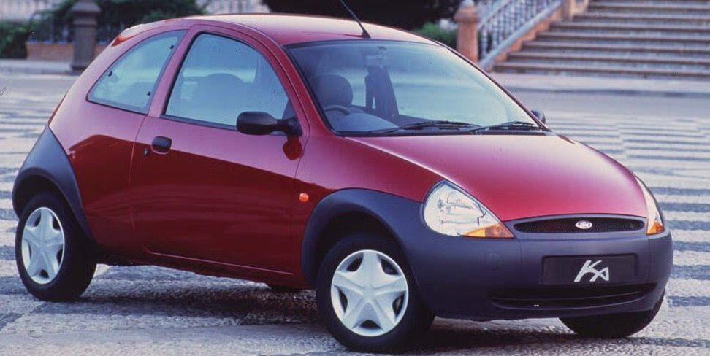
Conclusion
I would recommend both Psychographic Data analysis and Demographic Data Analysis because Psychographic Data analysis can explore what types of cars potential customers would like to buy, and Demographic Data Analysis can know what types of people could be our target customers.
Ford Ka should target the younger and older male customers with less number of children who like fashion small cars with high quality and safety from the conclusion of Psychographic Data Analysis and Demographic Data Analysis.
I suggest to send advertising message that including high safety, high quality, fashion, small internal space for convenience and ability to handle long motorway journeys.

Slide 11
Citation

Slide 12
THANK YOU FOR LISTENING!

